Slide 1
Final Exam Presentation
Team #1: Ellie Parobek, John Warner, Ryan Garcia

Slide 2

Data Mart Universe of Discourse
This data mart will cover the performance measures relevant to the sale of different products made across all three divisions.

Slide 3
Information Package

Slide 4
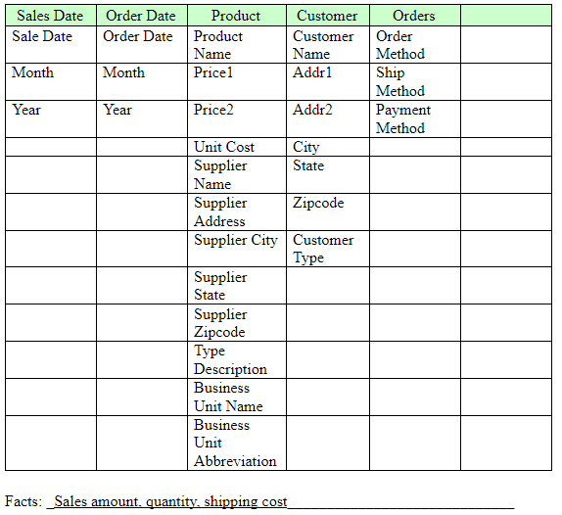
Process Name: Invoicing
Grain: Individual invoice records

Slide 5
Entity Definitions

Slide 6
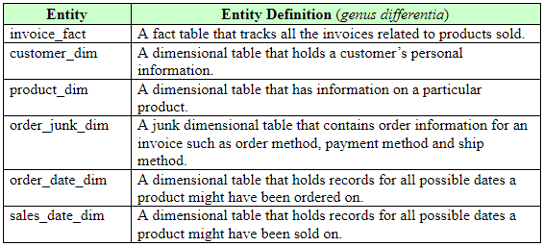

Slide 7
Dimensional Model

Slide 8
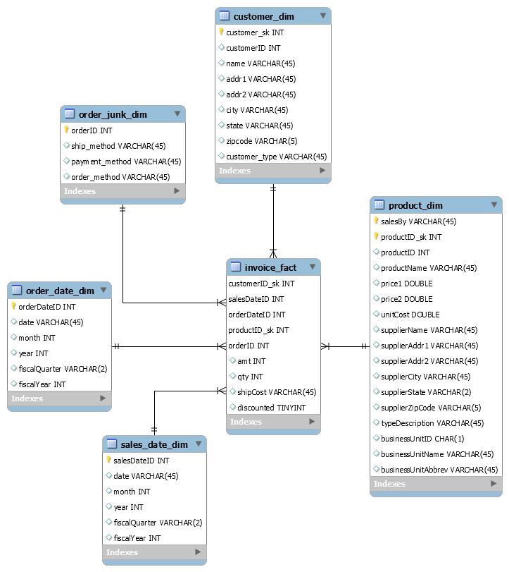

Slide 9

Data Staging: ETL – Data Extract File Definitions

Slide 10
Data Staging: ETL – Data Extract File Definitions
businessUnit.csv: Loaded into the business unit dimension originally, but was later removed and combined with the product dimension (see section X.Appendix - Product Dim).
customer.csv: Contains all customer dimensional data.
invoice.csv: Contains all invoice fact table data.
orderDate.csv: Contains all order date dimensional data.
orderJunk.csv: Contains all order junk dimensional data.
PECproduct.csv: Contains the PEC related product dimensional data.
salesDate.csv: Contains all sales date dimensional data.
TPCEproduct.csv: Contains the TPCE related product dimensional data.
TPCWproduct.csv: Contains the TPCW related product dimensional data.
All loaded files are located under ‘434Final_Team01_2201/Files Loaded’.

Slide 11
Data Staging: ETL – Source-to-Target Mappings

Slide 12
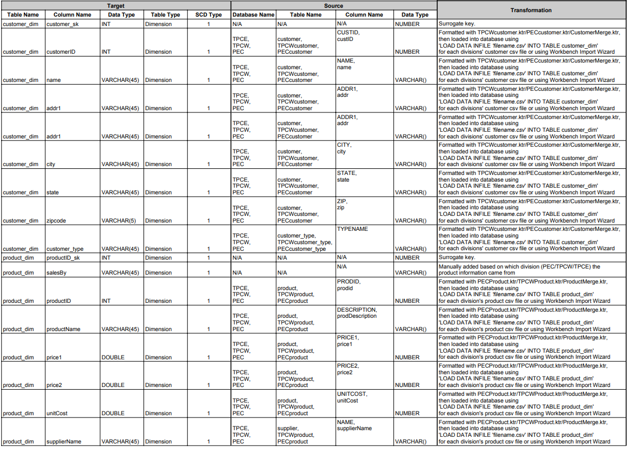
1/3

Slide 13
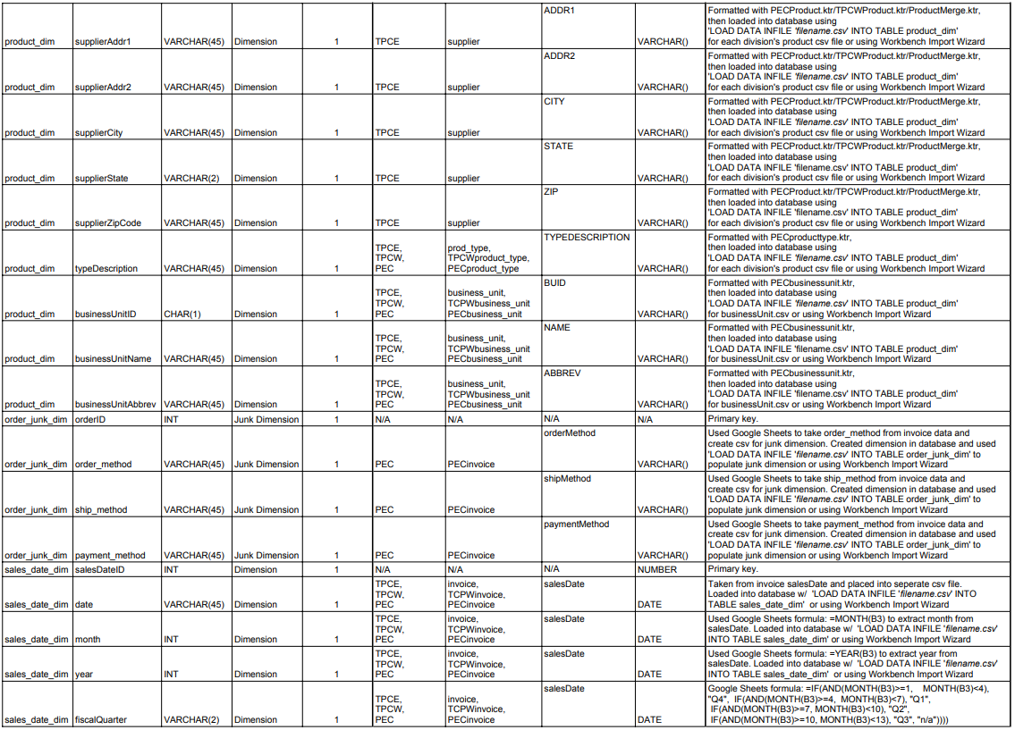
2/3

Slide 14
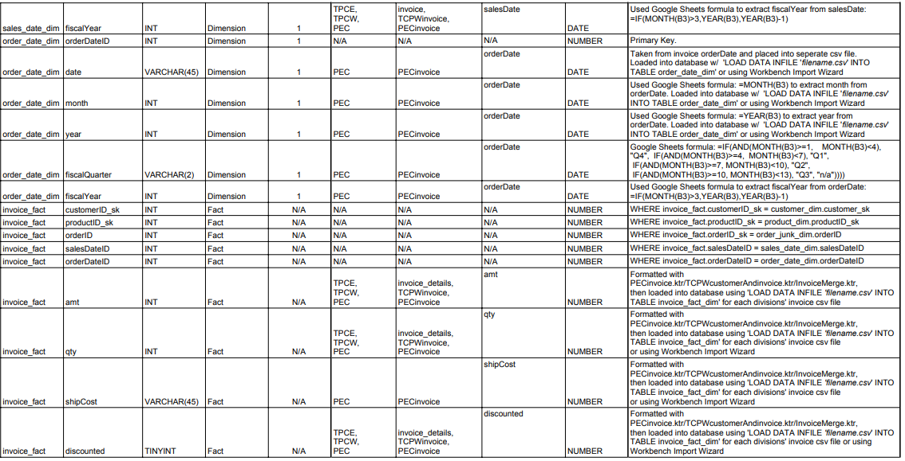
3/3

Slide 15
SQL Schema Code

Slide 16
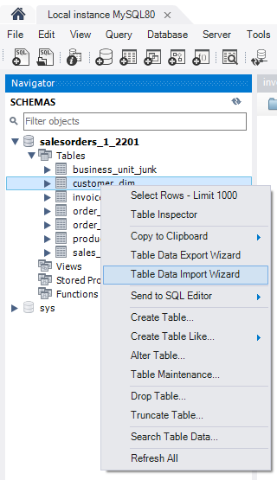
SQL Schema Code
All data was loaded with the CSV files stated in section III.Data Staging: ETL – Data Extract File Definitions using the MySQL Workbench ‘Table Data Import Wizard’.

Slide 17
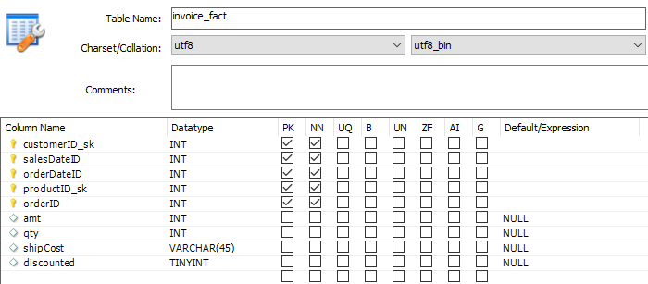
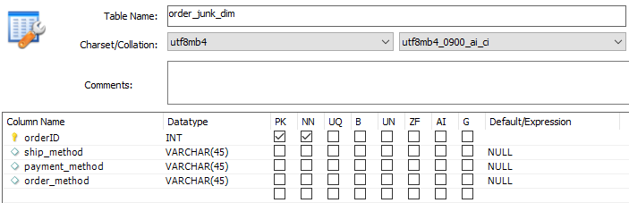
CREATE TABLE `invoice_fact` (
`customerID_sk` int NOT NULL,
`salesDateID` int NOT NULL,
`orderDateID` int NOT NULL,
`productID_sk` int NOT NULL,
`orderID` int NOT NULL,
`amt` int DEFAULT NULL,
`qty` int DEFAULT NULL,
`shipCost` varchar(45) DEFAULT NULL,
`discounted` tinyint DEFAULT NULL,
PRIMARY KEY (`customerID_sk`,`salesDateID`,`orderDateID`,`productID_sk`,`orderID`),
KEY `salesDateID_idx` (`salesDateID`),
KEY `productID_sk_idx` (`productID_sk`),
KEY `orderDateID_idx` (`orderDateID`),
KEY `orderID_idx` (`orderID`),
CONSTRAINT `customerID_sk` FOREIGN KEY (`customerID_sk`) REFERENCES `customer_dim` (`customer_sk`),
CONSTRAINT `orderDateID` FOREIGN KEY (`orderDateID`) REFERENCES `order_date_dim` (`orderDateID`),
CONSTRAINT `orderID` FOREIGN KEY (`orderID`) REFERENCES `order_junk_dim` (`orderID`) ON DELETE RESTRICT ON UPDATE RESTRICT,
CONSTRAINT `productID_sk` FOREIGN KEY (`productID_sk`) REFERENCES `product_dim` (`productID_sk`),
CONSTRAINT `salesDateID` FOREIGN KEY (`salesDateID`) REFERENCES `sales_date_dim` (`salesDateID`)
)
CREATE TABLE `order_junk_dim` (
`orderID` int NOT NULL,
`ship_method` varchar(45) DEFAULT NULL,
`payment_method` varchar(45) DEFAULT NULL,
`order_method` varchar(45) DEFAULT NULL,
PRIMARY KEY (`orderID`)
)

Slide 18
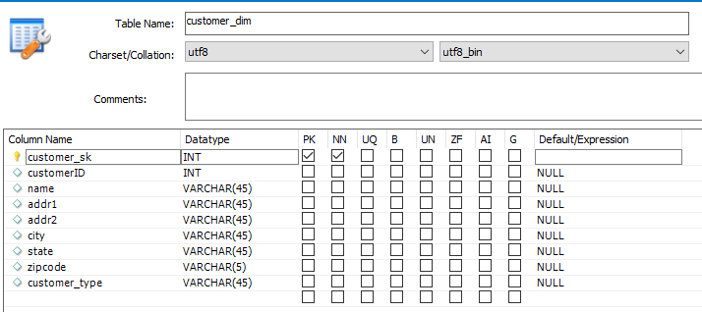
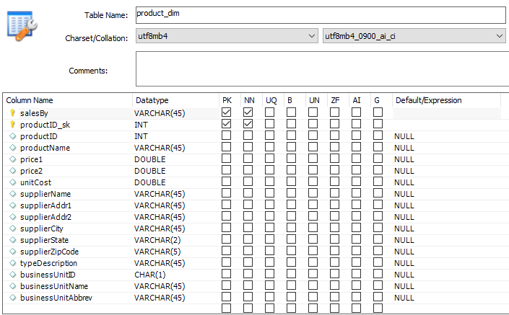
CREATE TABLE `customer_dim` (
`customer_sk` int NOT NULL,
`customerID` int DEFAULT NULL,
`name` varchar(45) DEFAULT NULL,
`addr1` varchar(45) DEFAULT NULL,
`addr2` varchar(45) DEFAULT NULL,
`city` varchar(45) DEFAULT NULL,
`state` varchar(45) DEFAULT NULL,
`zipcode` varchar(5) DEFAULT NULL,
`customer_type` varchar(45) DEFAULT NULL,
PRIMARY KEY (`customer_sk`)
)
CREATE TABLE `product_dim` (
`salesBy` varchar(45) CHARACTER SET utf8 NOT NULL,
`productID_sk` int NOT NULL,
`productID` int DEFAULT NULL,
`productName` varchar(45) CHARACTER SET utf8 DEFAULT NULL,
`price1` double DEFAULT NULL,
`price2` double DEFAULT NULL,
`unitCost` double DEFAULT NULL,
`supplierName` varchar(45) CHARACTER SET utf8 DEFAULT NULL,
`supplierAddr1` varchar(45) CHARACTER SET utf8 DEFAULT NULL,
`supplierAddr2` varchar(45) CHARACTER SET utf8 DEFAULT NULL,
`supplierCity` varchar(45) CHARACTER SET utf8 DEFAULT NULL,
`supplierState` varchar(2) CHARACTER SET utf8 DEFAULT NULL,
`supplierZipCode` varchar(5) CHARACTER SET utf8 DEFAULT NULL,
`typeDescription` varchar(45) CHARACTER SET utf8 DEFAULT NULL,
`businessUnitID` char(1) CHARACTER SET utf8 DEFAULT NULL,
`businessUnitName` varchar(45) CHARACTER SET utf8 DEFAULT NULL,
`businessUnitAbbrev` varchar(45) CHARACTER SET utf8 DEFAULT NULL,
PRIMARY KEY (`salesBy`,`productID_sk`),
KEY `productID_sk` (`productID_sk`)
)

Slide 19
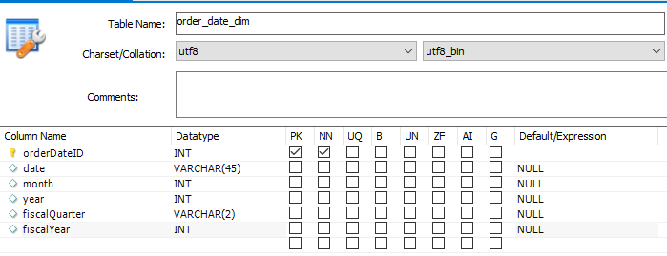
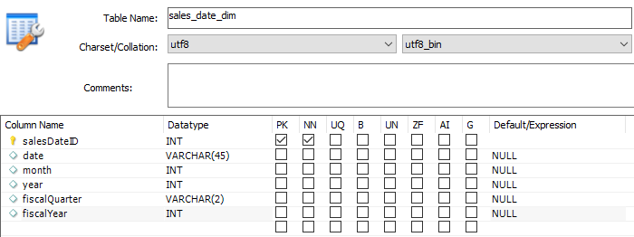
CREATE TABLE `order_date_dim` (
`orderDateID` int NOT NULL,
`date` varchar(45) DEFAULT NULL,
`month` int DEFAULT NULL,
`year` int DEFAULT NULL,
`fiscalQuarter` varchar(2) DEFAULT NULL,
`fiscalYear` int DEFAULT NULL,
PRIMARY KEY (`orderDateID`)
)
CREATE TABLE `sales_date_dim` (
`salesDateID` int NOT NULL,
`date` varchar(45) DEFAULT NULL,
`month` int DEFAULT NULL,
`year` int DEFAULT NULL,
`fiscalQuarter` varchar(2) DEFAULT NULL,
`fiscalYear` int DEFAULT NULL,
PRIMARY KEY (`salesDateID`)
)

Slide 20
Data Cleansing Activities

Slide 21
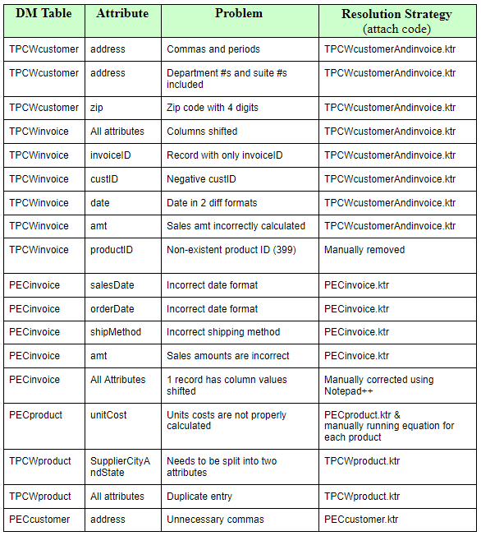

Slide 22
Data Transformation Process

Slide 23
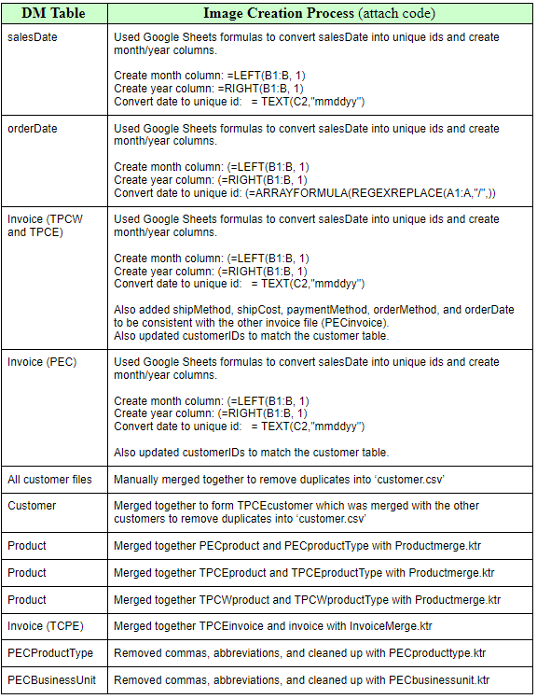

Slide 24
Table Population Process

Slide 25
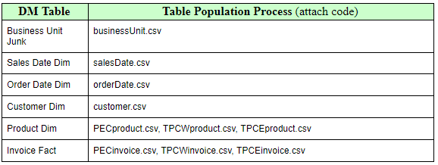

Slide 26

End User Applications

Slide 27
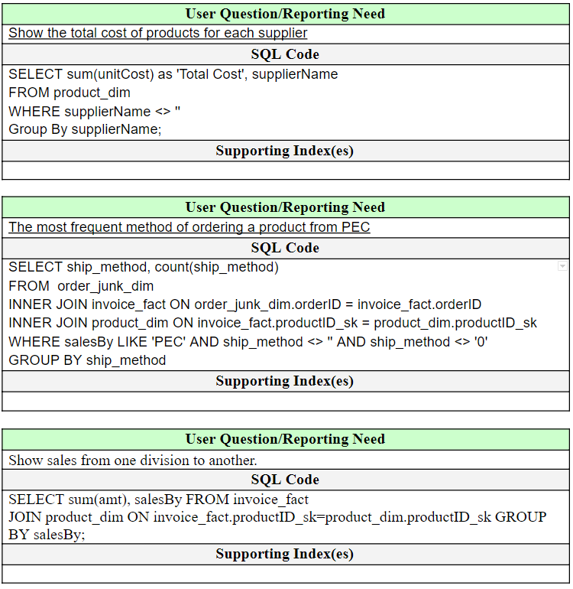
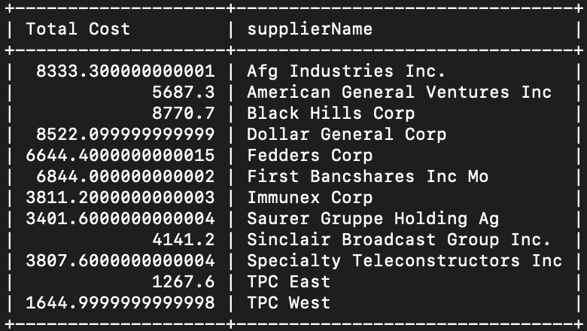
Queries - Query #1

Slide 28
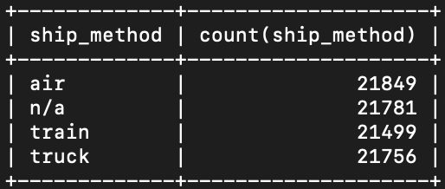
Queries - Query #2

Slide 29
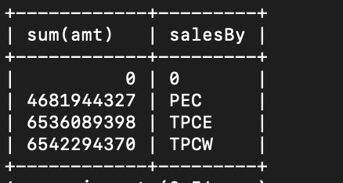
Queries - Query #3

Slide 30
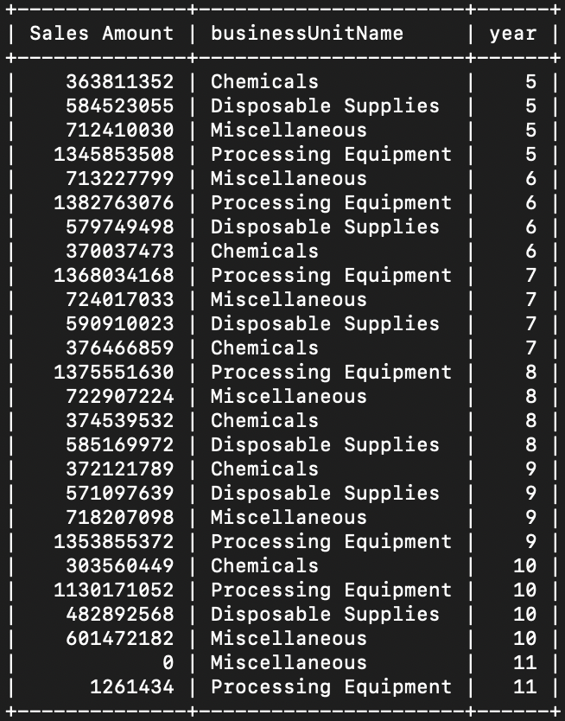
View - Addressing Reporting Needs
Sample Code:
SELECT sum(amt) as 'Sales Amount', product_dim.businessUnitName,sales_date_dim.year FROM invoice_fact join product_dim ON invoice_fact.productID_sk=product_dim.productID_sk JOIN sales_date_dim ON invoice_fact.salesDateID=sales_date_dim.salesDateID GROUP BY product_dim.businessUnitName, sales_date_dim.year ORDER BY sales_date_dim.year;

Slide 31
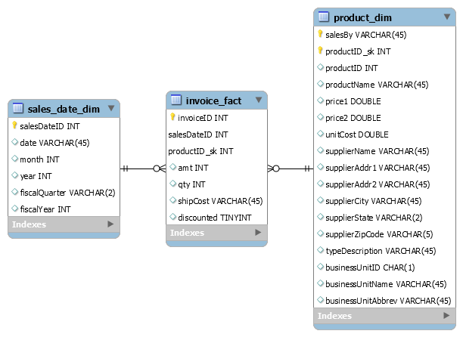
Aggregated Data Mart - Lost Dimension

Slide 32
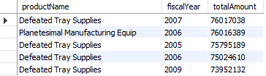
Aggregated Data Mart - Lost Dimension
Query #1: Top 5 Products by Amount Sold and Corresponding Fiscal Year
SELECT productName, fiscalYear, sum(amt) as ‘totalAmount’ FROM invoice_fact JOIN product_dim ON invoice_fact.productID_sk = product_dim.productID_sk JOIN sales_date_dim ON invoice_fact.salesDateID = sales_date_dim.salesDateID GROUP BY productName, fiscalYear ORDER BY sum(amt) DESC LIMIT 5

Slide 33
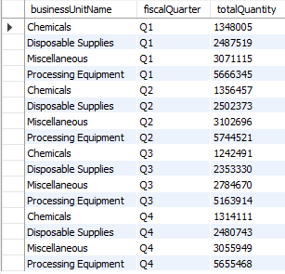
Aggregated Data Mart - Lost Dimension
Query #2: Top Quantity of Products Sold By Business Unit Name For Each Fiscal Quarter
SELECT businessUnitName, fiscalQuarter, sum(qty) as 'totalQuantity' FROM invoice_fact JOIN product_dim ON invoice_fact.productID_sk = product_dim.productID_sk JOIN sales_date_dim ON invoice_fact.salesDateID = sales_date_dim.salesDateID GROUP BY businessUnitName, fiscalQuarter ORDER BY fiscalQuarter, businessUnitName ASC

Slide 34
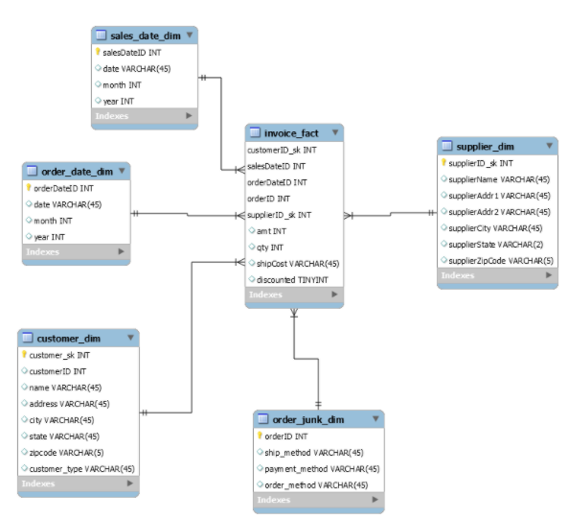
Aggregated Data Mart - Shrunken Dimension

Slide 35
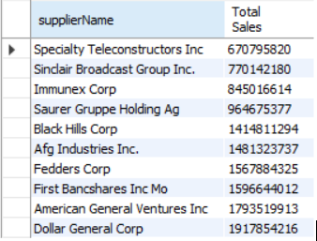
Aggregated Data Mart - Shrunken Dimension
Query #1: Top Ten Suppliers With The Least Amount of Sales
SELECT supplier_dim.supplierName, sum(invoice_fact.amt) FROM invoice_fact JOIN supplier_dim ON invoice_fact.supplierID_sk = supplier_dim.supplierID_sk GROUP BY supplierName HAVING sum(invoice_fact.amt) > 0 ORDER BY sum(invoice_fact.amt) ASC LIMIT 10

Slide 36
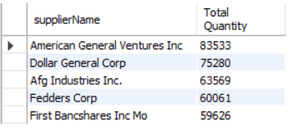
Aggregated Data Mart - Shrunken Dimension
Query #1: Top Five Suppliers With The Most Quantity Sold in January 2010
SELECT supplier_dim.supplierName, sum(invoice_fact.qty) FROM invoice_fact JOIN supplier_dim ON invoice_fact.supplierID_sk = supplier_dim.supplierID_sk JOIN sales_date_dim ON invoice_fact.salesDateID = sales_date_dim.salesDateID WHERE sales_date_dim.month = 1 AND sales_date_dim.year = 10 GROUP BY supplierName ORDER BY sum(invoice_fact.qty) DESC LIMIT 5

Slide 37
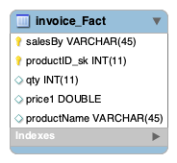
Aggregated Data Mart - Collapsed Dimension

Slide 38
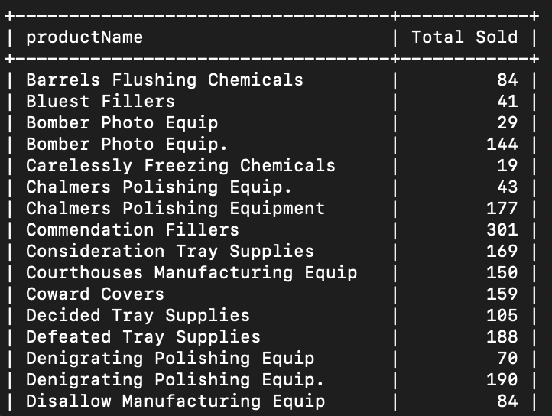
Aggregated Data Mart - Collapsed Dimension
Query #1: Total Number of a Product Sold
SELECT productName, sum(qty) as 'Total Sold' FROM invoice_fact GROUP BY productName;

Slide 39
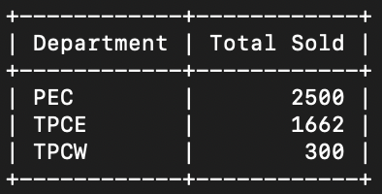
Aggregated Data Mart - Collapsed Dimension
Query #2: Total Number of Products Sold By Department
SELECT salesBy as 'Department', sum(qty) as 'Total Sold' FROM invoice_fact GROUP BY salesBy;

Slide 40
Slowly Changing Dimensions

Slide 41
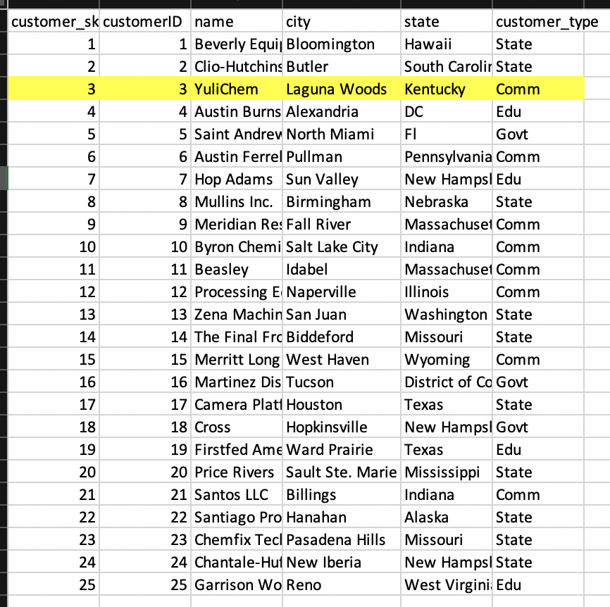
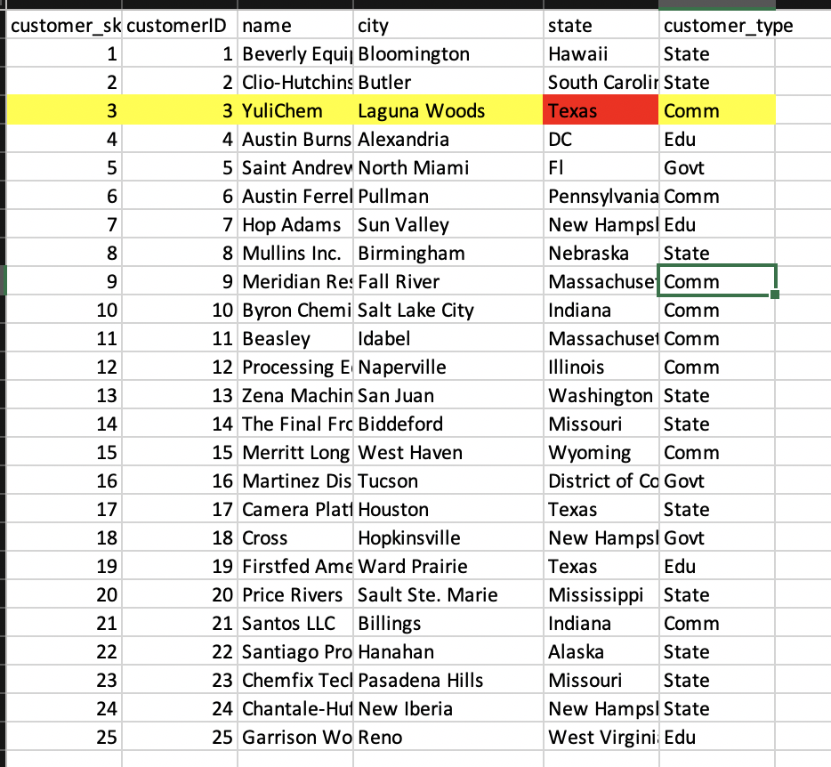
Customer Type 0
Customer Type 1

Slide 42
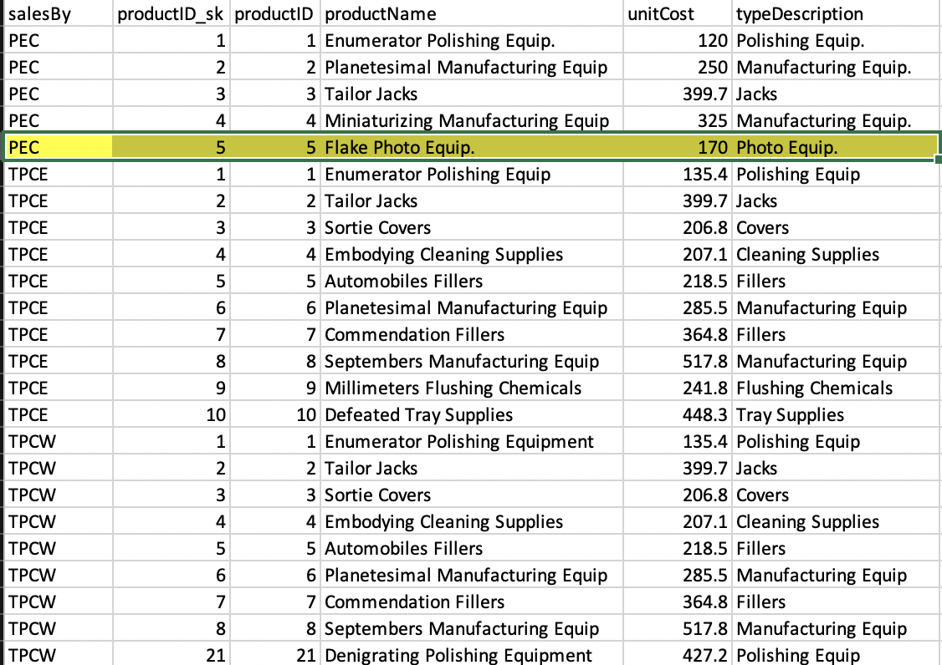
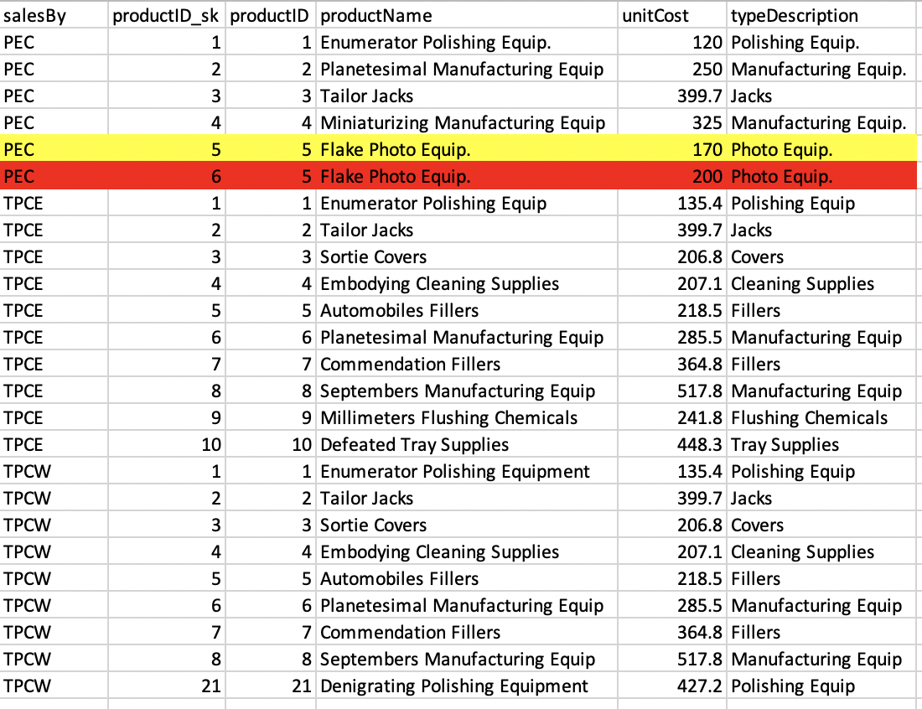
Product Type 0
Product Type 2

Slide 43
N:M Implementation

Slide 44
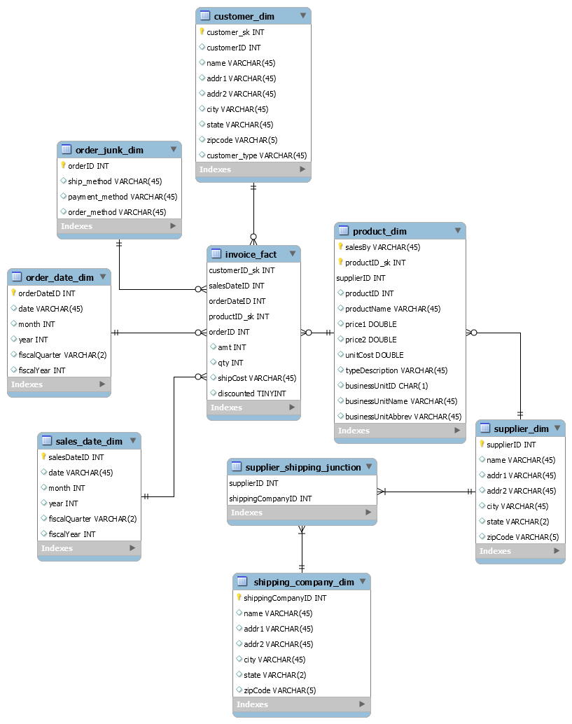
N:M Implementation
Instead of just linking the supplier and shipping company tables together, the implementation decided upon was to utilize a Junction/Joining Table
First, the supplier information was pulled out of the product dimension and placed into its own dimension - supplier_dim.
Then, the shipping company dimension was created with shipping company data - shippping_company_dim.
Finally, we can connect these two dimensions using the junction table - supplier_shipping_junction
Another, simpler method of many-to-many relationships is to just link the two tables together
But this means we cannot have the primary keys stored in either table, requiring either a column that contains multiple values or multiple columns for each unique ID.
This is very much not ideal as it will make SQL queries much more difficult and harder to maintain.

Slide 45
Appendix: Lab #3 Corrections

Slide 46
Lab #3 Corrected Issues
PECcustomer.csv: Address not split into addr1 & addr2
Manually created addr1 and addr2 to split any department numbers, suite numbers, and PO boxes into addr2.
TPCWproduct.csv: Contained duplicate products
Manually removed the duplicate products:
TPCWcustomer.csv: F
Manually created addr1 and addr2 to split any department numbers, suite numbers, and PO boxes into addr2.
Manually prefixed zip codes with 4 digits with 0’s instead of 1’s.
TPCWinvoice.csv:
Incorrected shifted column- manually updated invoice with invoiceID = 3032.
Manually removed the record with only invoiceID, ID = 26511.
Fixed date format to match the ‘PECinvoiceClean.csv’ date format.
Uniformity among all files:
Fixed using Google Sheets to have all files use the shorthand version with periods.

Slide 47
Lab #3 Corrected Issues
Customer Dim:
Updated state field to have all states use abbreviations using Google Sheets in all caps.
Manually created addr1 and addr2 to split any department numbers, suite numbers, and PO boxes into addr2.
Duplications removed.
Product Dim:
Added business unit information to the product dimension using SQL code. Then removed the business_unit_junk dim and replaced the old product_dim with the new_product_dim.
‘SalesBy’ field.
Updated state field to have all states use abbreviations using Google Sheets in all caps.
TPC West,TPC East, and PEC listed as suppliers when appropriate.
Order Date Dim:
Added fiscal date through Google Sheets..
Sales Date Dim:
Added fiscal date through Google Sheets.
Junk Dim:
Junk dimension updated from business_unit_junk to order_junk_dim.
Fact Table:
Added a null record for each dimension that did not already have one.
Query 3:
Fixed in section ‘VII.End User Applications - Queries’.

